Slide 1


Retrieverdux
An introduction to Redux and a Golden Retriever Named Mr. Bingley

Slide 2

HI, I’m Janine!
Tarheel, Software engineer at BitSight Technologies (We’re hiring!)
ReactJS enthusiast, front-end specialist
Golden Retriever mom to Mr. Bingley (@bingleythegoldennc)
Avid hiker, reader, and nerd
Contact: janine.love@bitsighttech.com

Slide 3
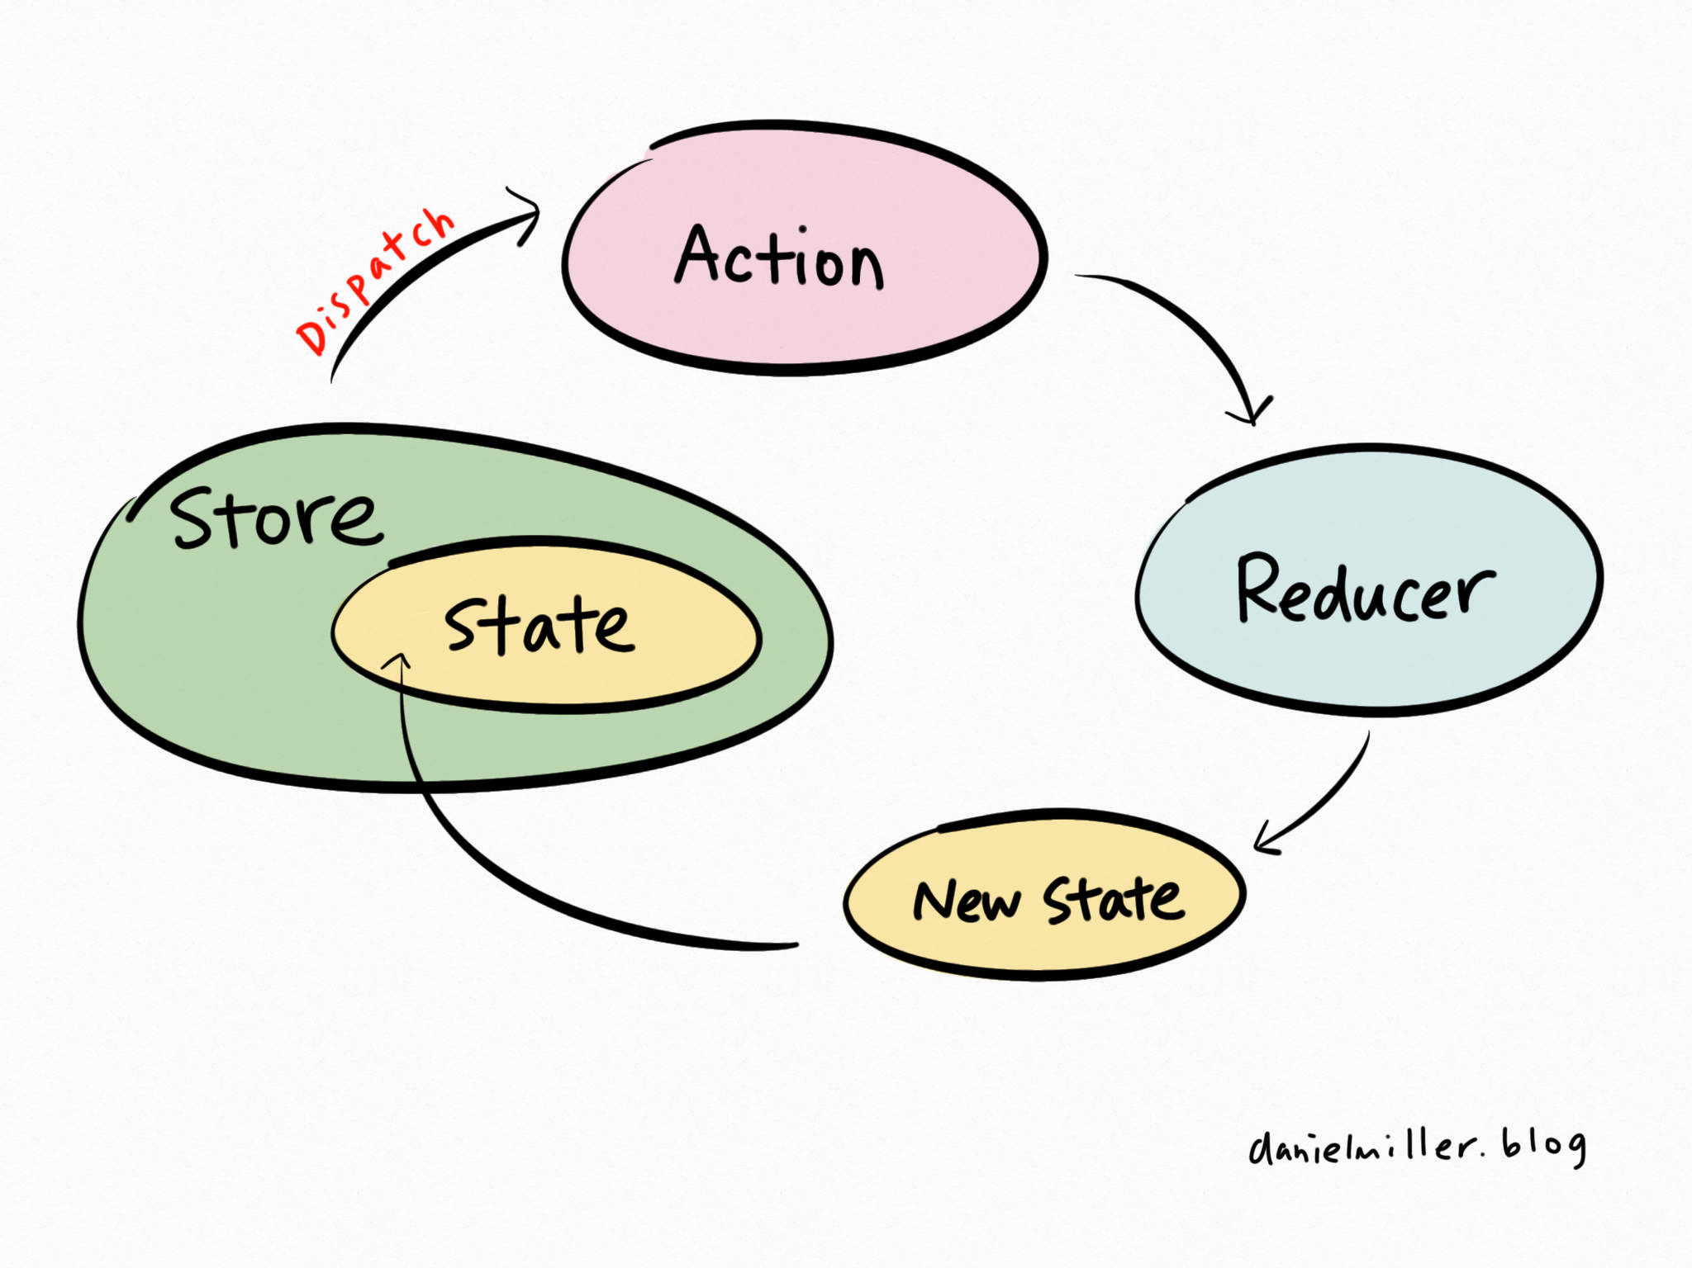
Today’s Presentation Objectives

Slide 4


What is Redux?

Slide 5
Redux
From the docs:
Redux is a predictable state container for JavaScript apps.
It helps you write applications that behave consistently, run in different environments (client, server, and native), and are easy to test.
In plain English:
Redux helps you store and manipulate data on the frontend

Slide 6
Redux is still pretty new!
Redux was created in 2015 by Dan Abramov and Andrew Clark.
Redux is inspired by Facebook’s Flux (more on this later) and influenced by the functional programming language Elm.
Redux is used with React primarily but not exclusively or mandatorily.

Slide 7

BingleyStore
How is Redux different from Backbone or Flux? Learn the first principle of Redux—the single immutable state tree. -- D. Abramov
Redux attempts to make state mutations predictable by imposing certain restrictions on how and when updates can happen.
It is the single source of truth.
Code-wise it is a plain javascript object.

Slide 8
The Redux Cycle
The whole state of your app is stored as a state object in a single store
To change your state, you must emit an action
To actually update your state, you use reducers

Slide 9

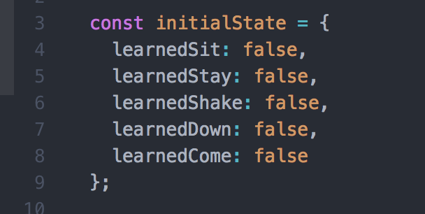
The State of a Golden Retriever

Slide 10
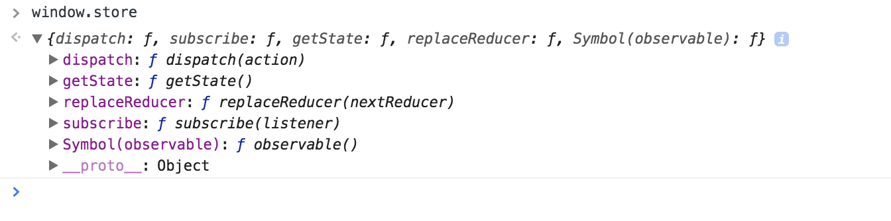
The store is just an object
The store has the following methods:
getState()
dispatch(action)
subscribe(listener)
replaceReducer(nextReducer)

Slide 11
getState()
From the docs:
Returns the current state tree of your application.
It is equal to the last value returned by the store's reducer.

Slide 12
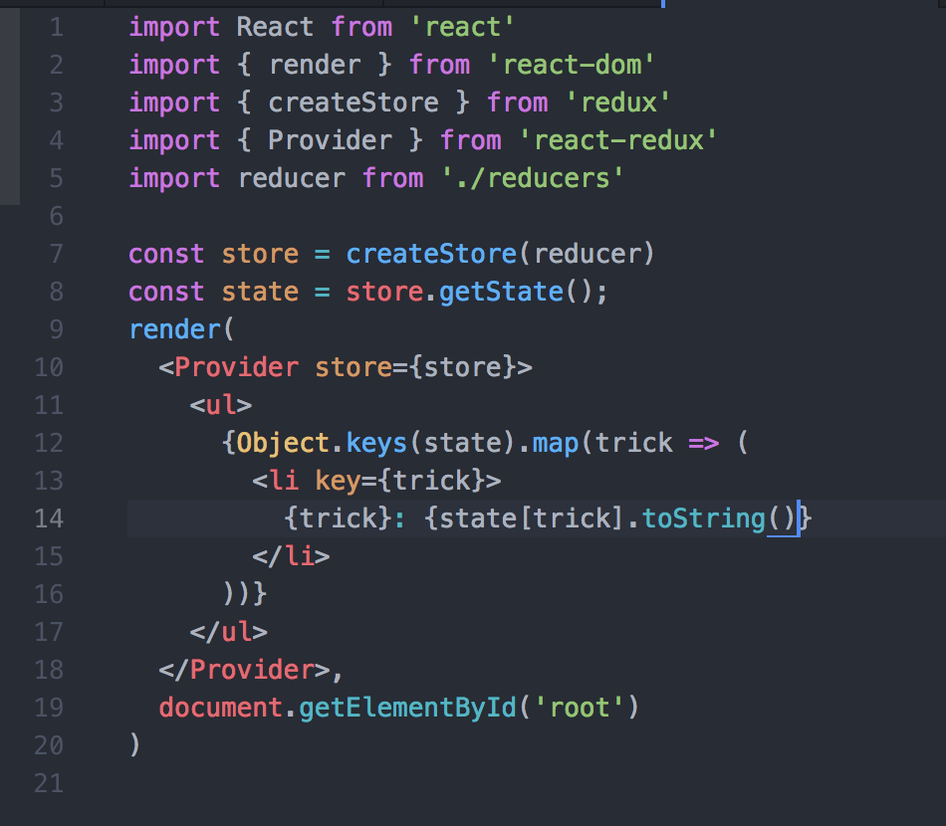
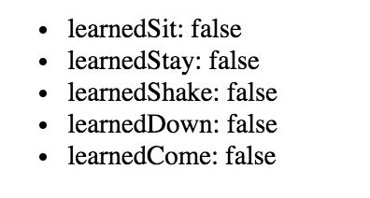

Slide 13
Dispatch(action)
Dispatching actions is how you change state in redux
This is the only way to trigger a state change.
An action is just a plain object, too
An action must supply a type field, which should be a string

Slide 14

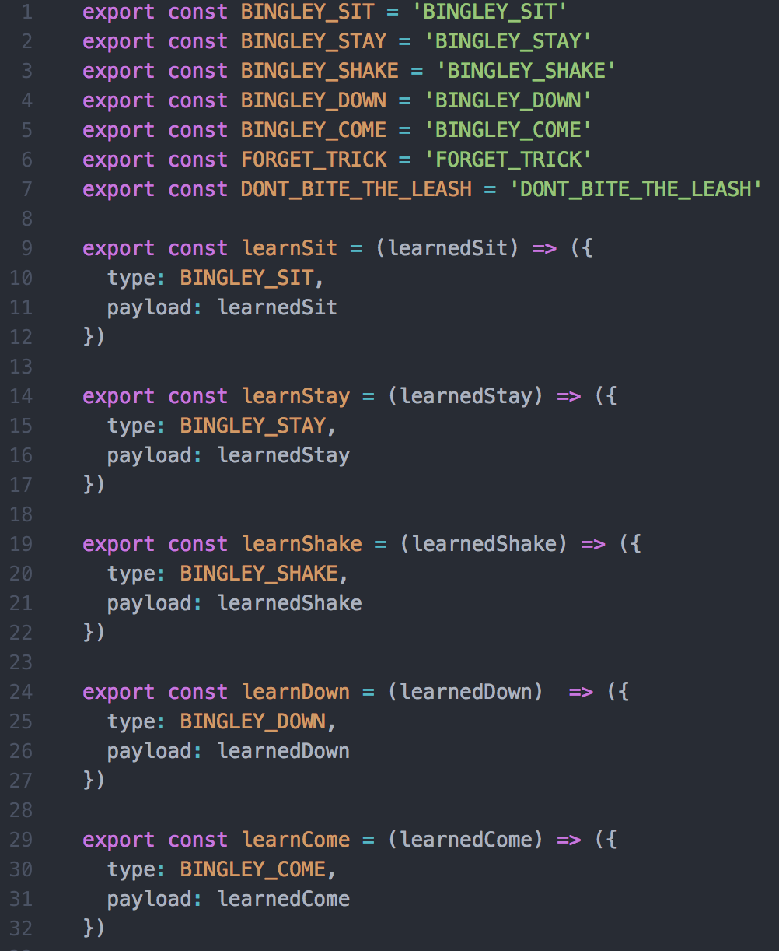

Slide 15
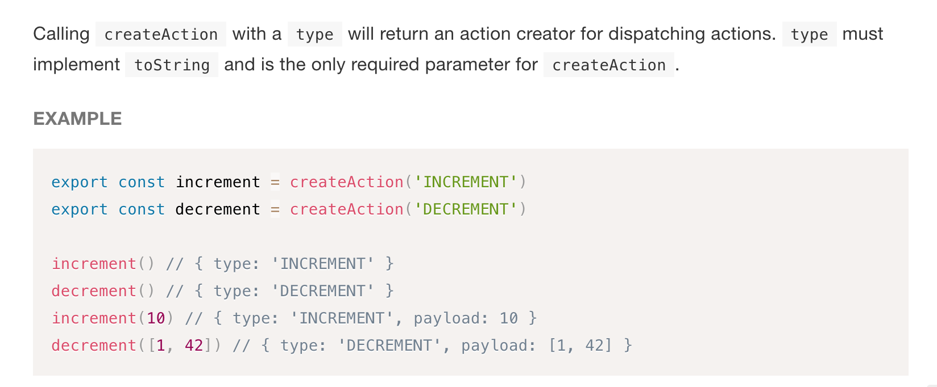
import { createAction } from 'redux-actions';

Slide 16
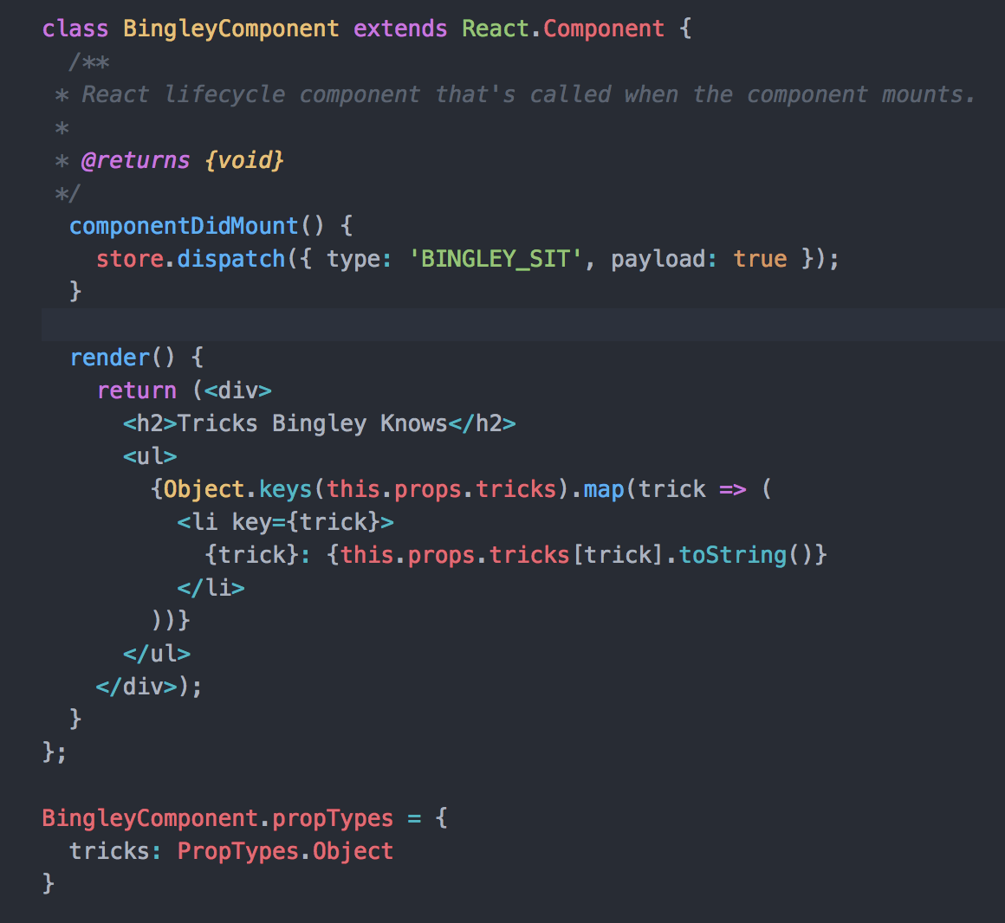
Do I need actions creators?
NO
But action creators allow for:
Code reusability and DRY code
Separation of concerns and easier debugging
Documentation
Encapsulation and consistency

Slide 17
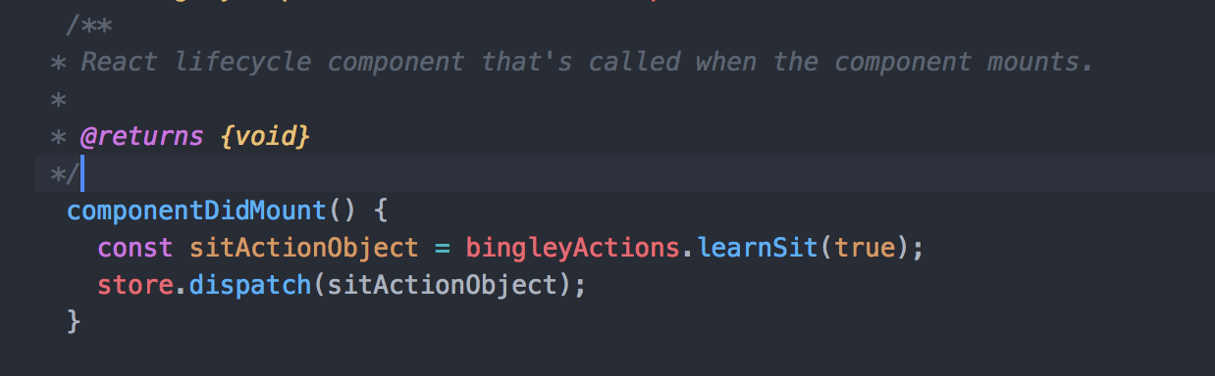
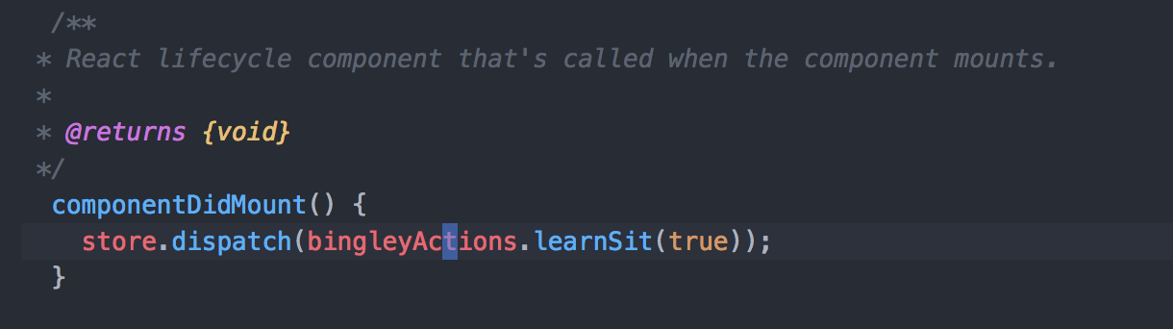
To dispatch an action:
Pass dispatch to props and create the action object inline (showed this already)
Use an action creator function
Directly pass results of action creator to dispatch
Pre-bind your creator to automatically call dispatch using bindActionCreators

Slide 18
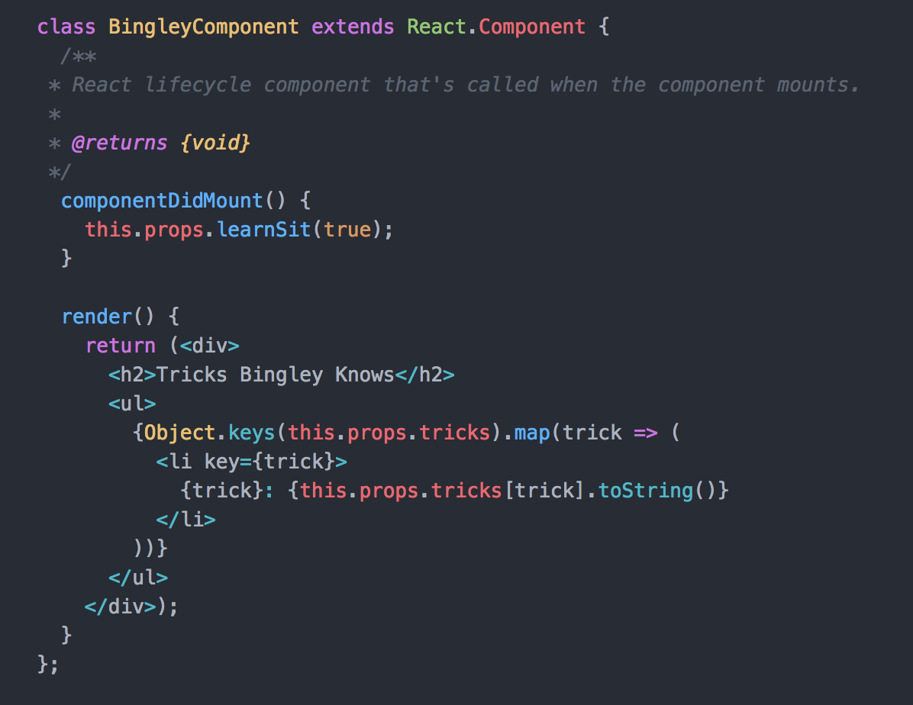
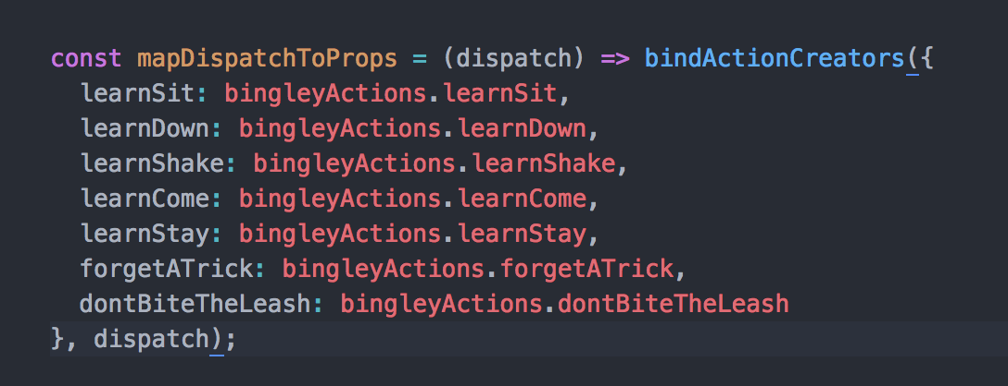
Do I need actions creators?

Slide 19
Which is best?
To me, the simplest and most idiomatic approach is to always use pre-bound action creators in your components. This removes the need for components to worry about dispatch, and makes them agnostic to Redux itself. (quote from Mark’s Dev Blog)
I also like to use ‘createAction’ (consistency, less error-prone) and the mapDispatchToProps utility function; it acts as documentation and clearly spells out developer intent.

Slide 20

We’ve dispatched an action; now what?

Slide 21

Reducers
From the Docs:
Actions describe the fact that something happened, but don't specify how the application's state changes in response. This is the job of reducers.

Slide 22
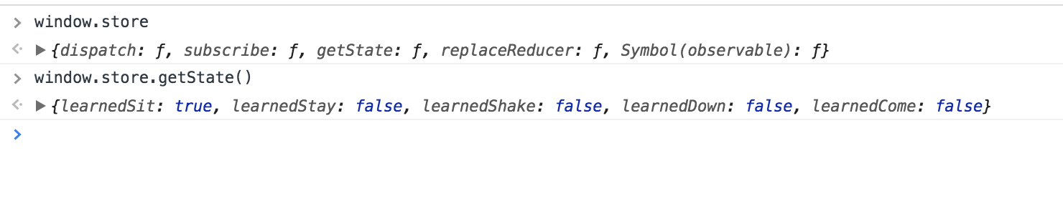
Remember: State is just an object

Slide 23
Pure Functions
Should not mutate their parameters
Should not produce any side-effects
Should be deterministic
Given the same arguments, it should calculate the next state and return it. No surprises. No side effects. No API calls. No mutations. Just a calculation.

Slide 24
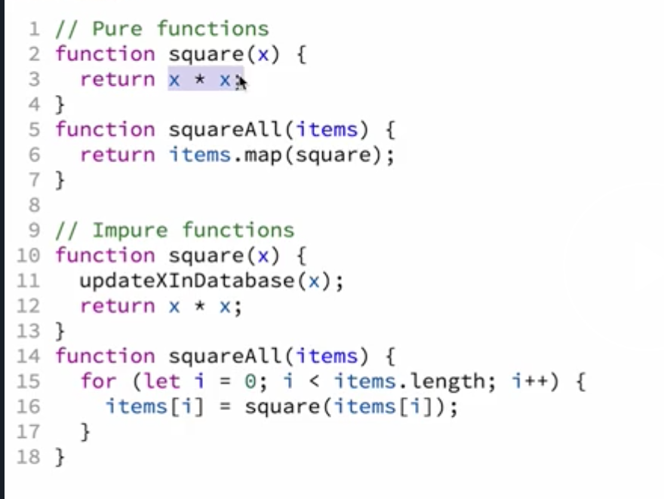
Pure Function Example

Slide 25
The Reducer Function
A pure function
Has a signature of (state, action) => state
Should have an initial state
Should return some state by default

Slide 26
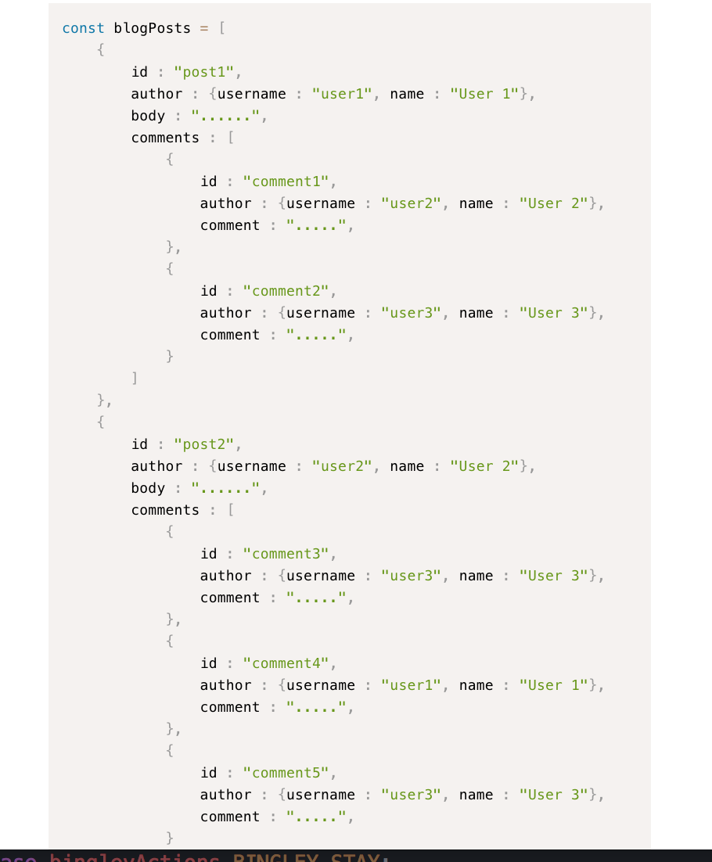
Initial state/Normalizing state shape
When designing your state, it should still reflect the relationships in a database

Slide 27
Normalized state
The basic concepts of normalizing data are:
Each type of data gets its own "table" in the state.
Each "data table" should store the individual items in an object, with the IDs of the items as keys and the items themselves as the values.
Any references to individual items should be done by storing the item's ID.
Arrays of IDs should be used to indicate ordering.

Slide 28
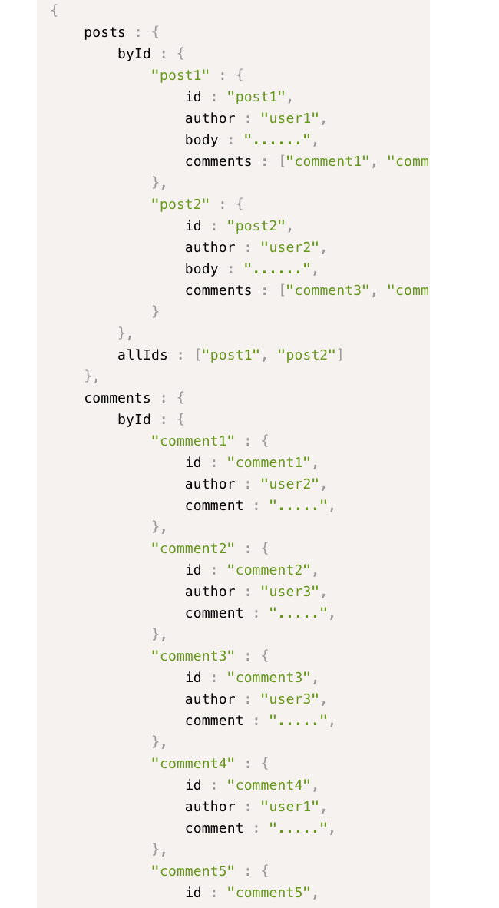
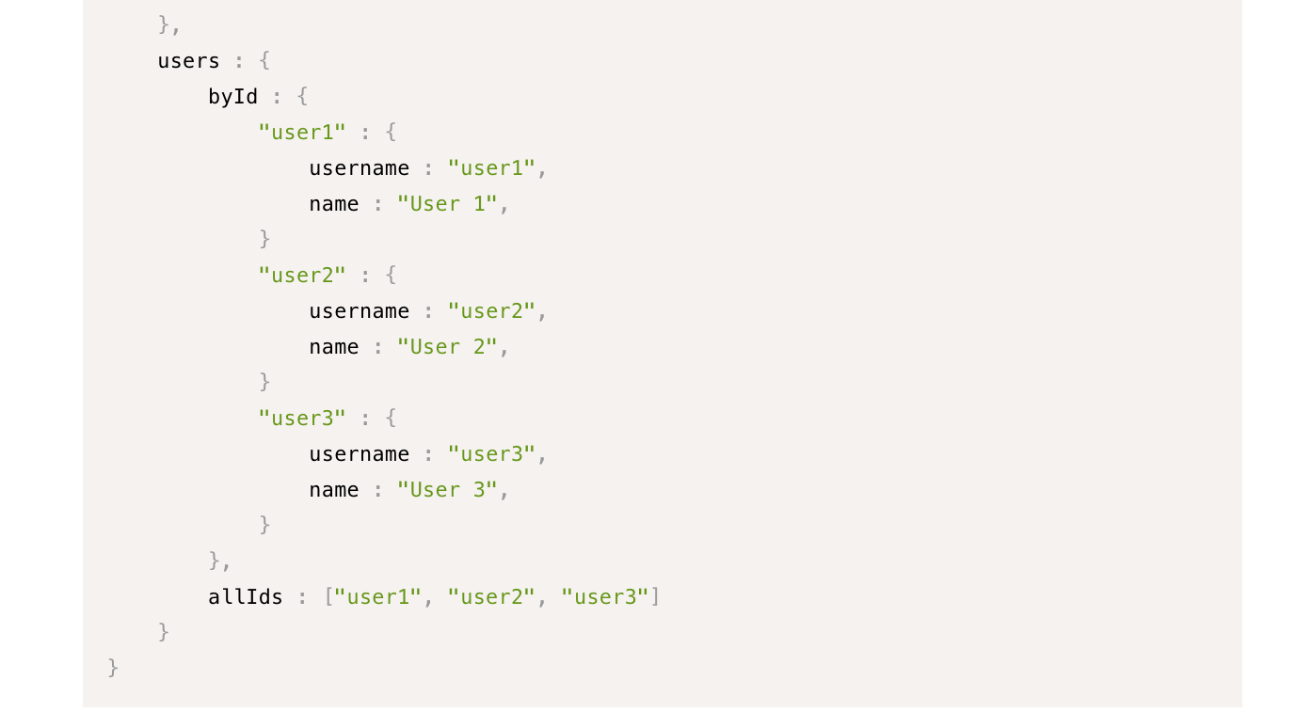
Improved State Design

Slide 29
Improved State Design
Because each item is only defined in one place, we don't have to try to make changes in multiple places if that item is updated.
The reducer logic doesn't have to deal with deep levels of nesting, so it will probably be much simpler.
The logic for retrieving or updating a given item is now fairly simple and consistent.
Since each data type is separated, an update like changing the text of a comment would only require new copies of the "comments > byId > comment" portion of the tree.

Slide 30
Why?
When a piece of data is duplicated in several places, it becomes harder to make sure that it is updated appropriately.
Nested data means that the corresponding reducer logic has to be more nested and therefore more complex. In particular, trying to update a deeply nested field can become very ugly very fast.
An update to a deeply nested data object could force totally unrelated UI components to re-render even if the data they're displaying hasn't actually changed.

Slide 31

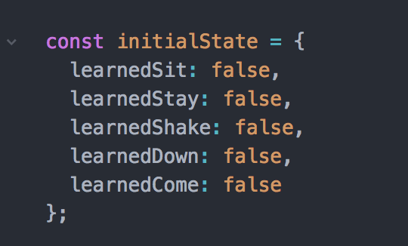
Bingley Store Example

Slide 32
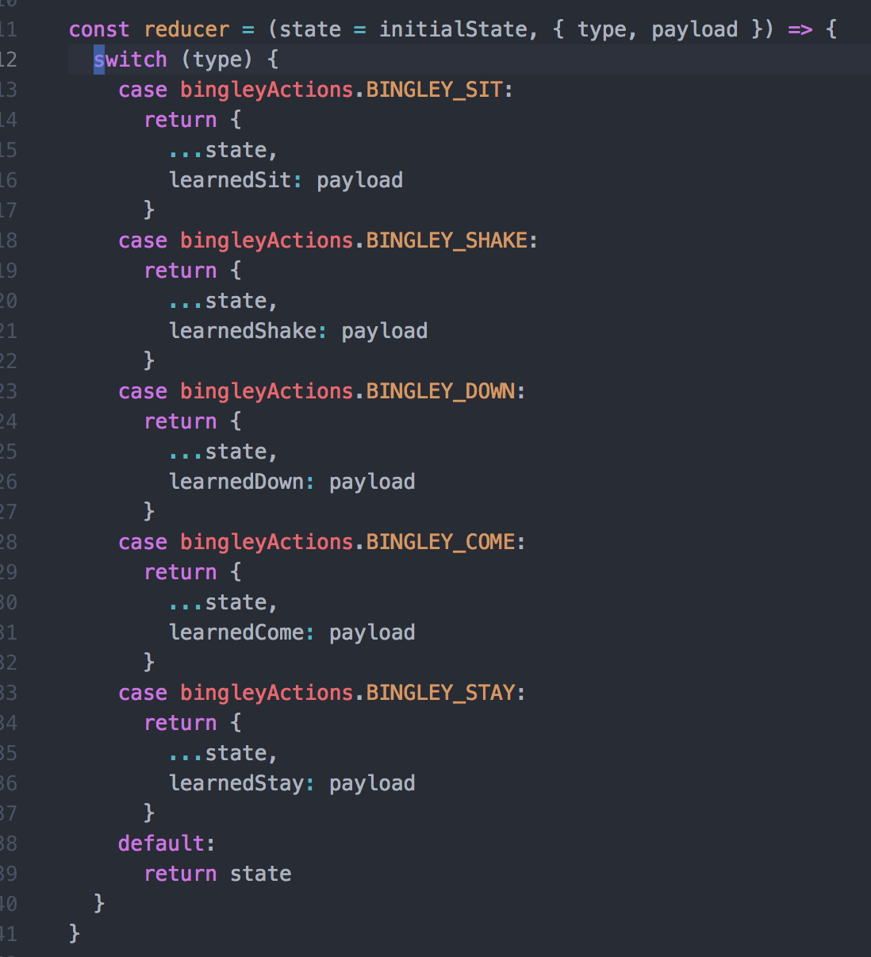
Back to Bingley State
In the beginning my state is equal to my initialState
If I emit an action that my reducer doesn’t recognize, my default state will return my previous state
I use the spread operator to avoid mutating my state (This could have been accomplished using Object.assign() as well)

Slide 33
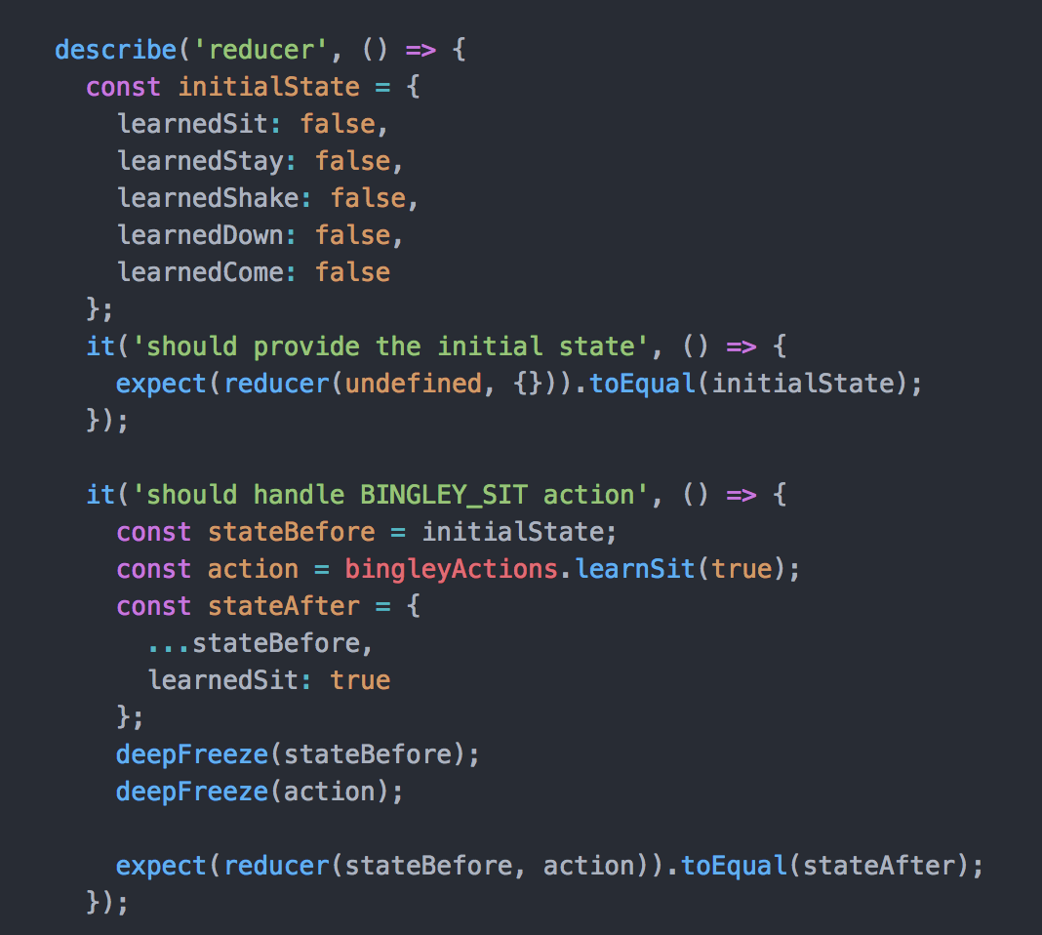
You should have some kind of initial state

Slide 34
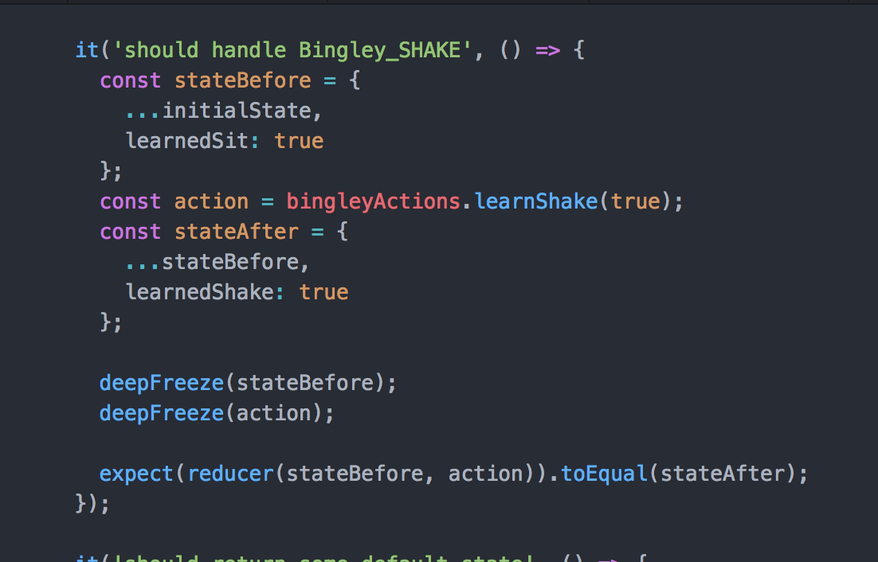
You should not mutate state upon update

Slide 35
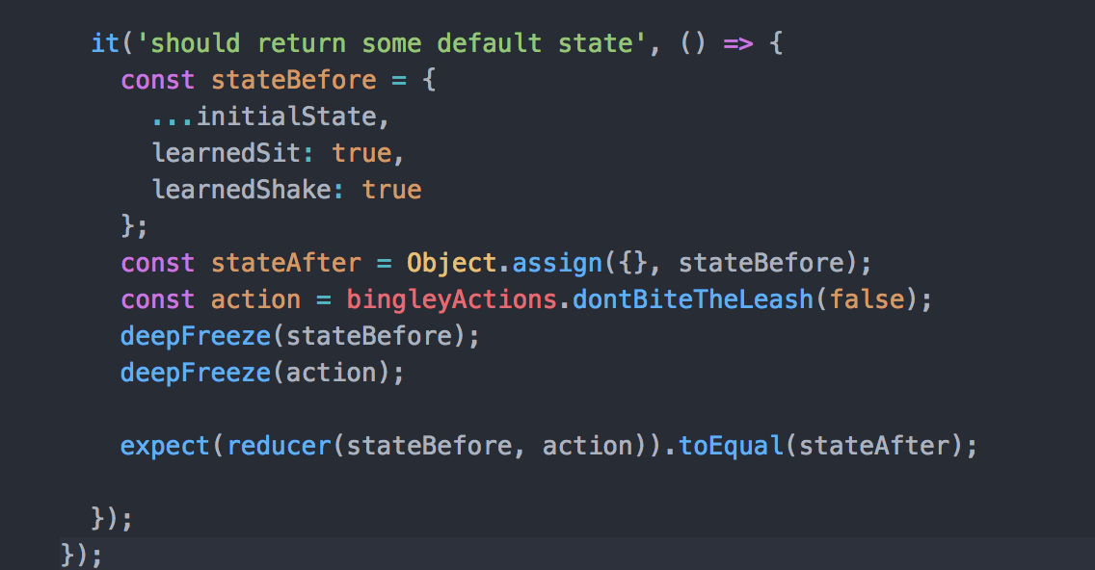

You should have a default

Slide 36
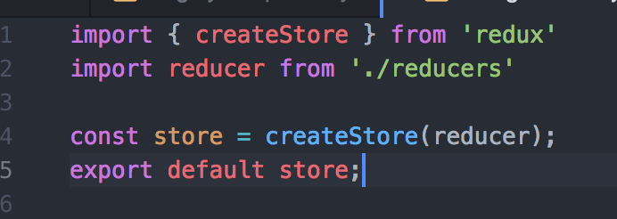
How do reducers relate to my store?

Slide 37
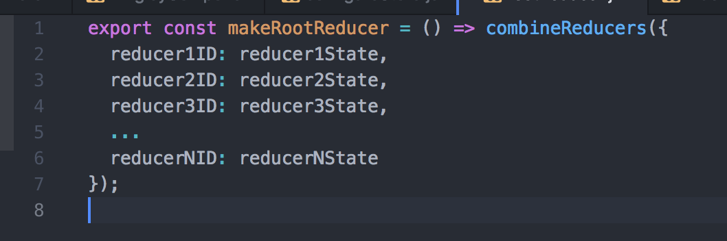
Can I have more than 1 reducer?

Slide 38

Just for fun

Slide 39
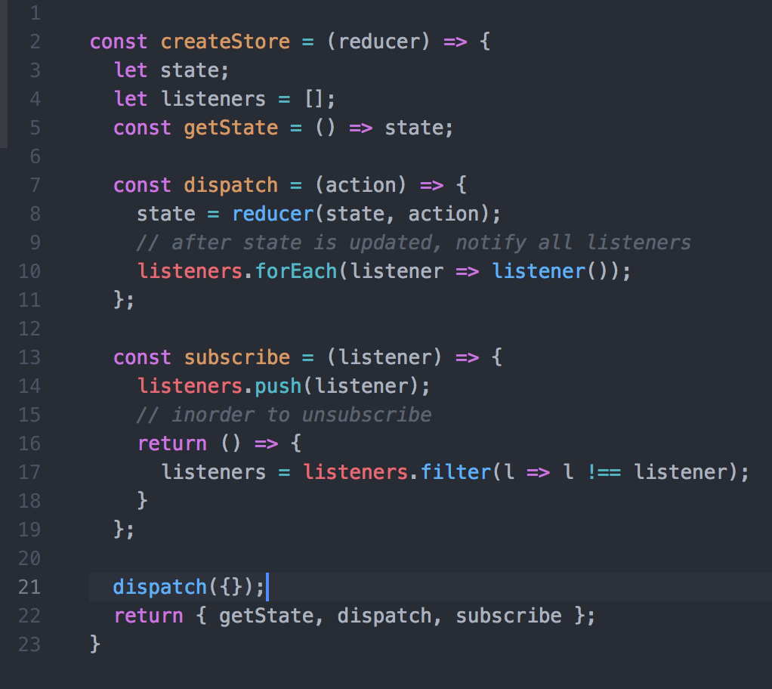

Slide 40
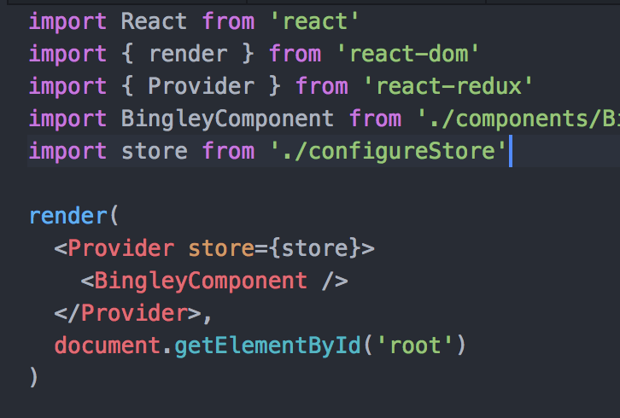
Provider
The Provider component: This is wrapped around the component tree. It makes it easy for the root component’s children to hook up to the store using connect() – which is considered the best way to access your store according to the docs

Slide 41
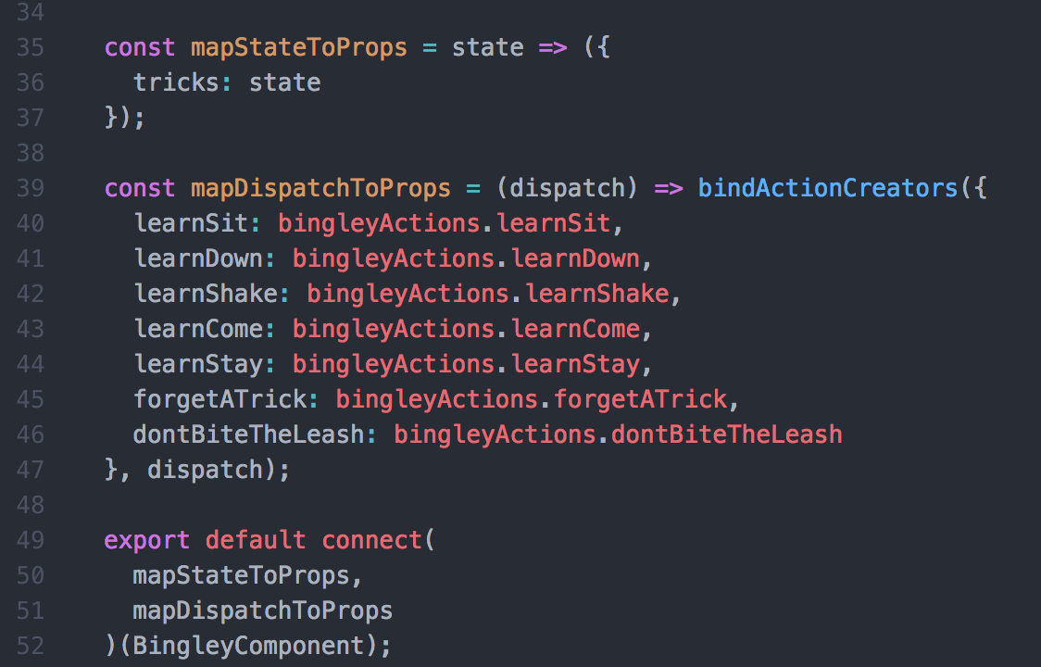
Ways to access your store
The connect() function
This allows you to map state and action creators to your component, and have them passed in automatically as your store updates. Additionally, by default it will pass in dispatch as this.props.dispatch
connect(): This is a function provided by react-redux. If a component wants to get state updates, it wraps itself using connect(). Then the connect function will set up all the wiring for it, using the selector (more on this to come).

Slide 42
Higher Order Components (HOCs)
Connect actually creates a new component that wraps around your existing one
For today’s intents and purposes, this just makes it so that the wrapping component can pass some additional props to the wrappee
For more info: https://medium.com/@dan_abramov/mixins-are-dead-long-live-higher-order-components-94a0d2f9e750

Slide 43
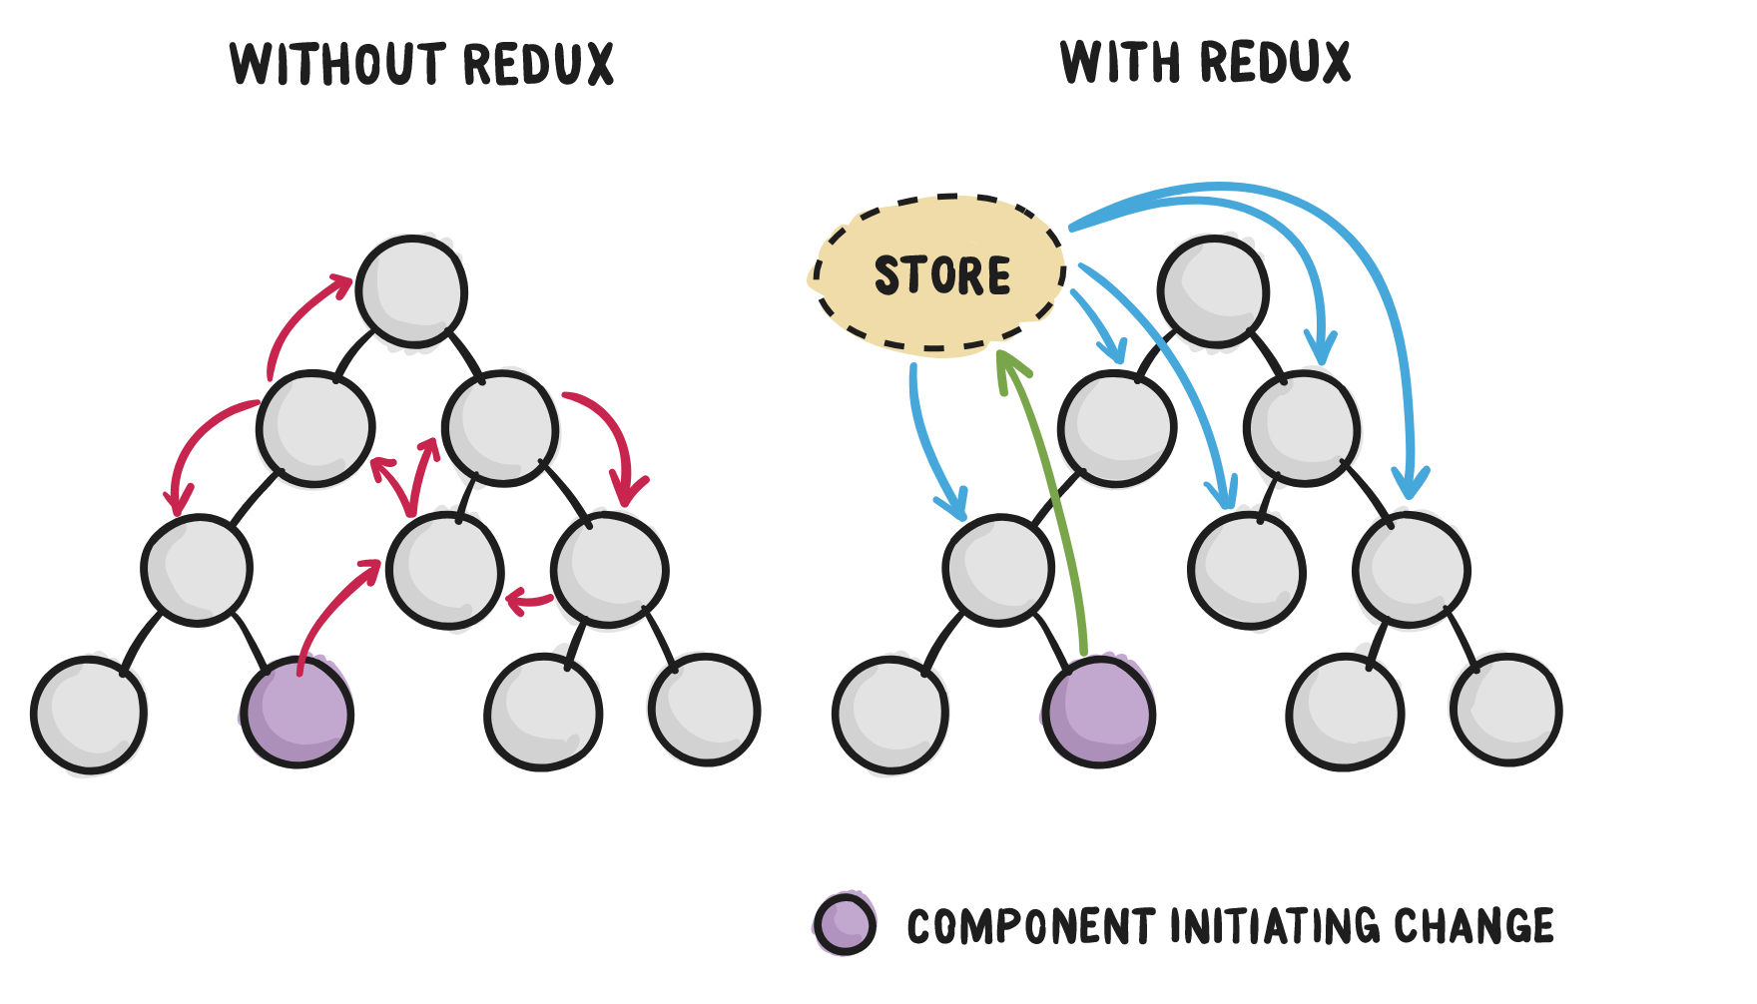
Why use Redux?
React doesn't recommend direct component-to-component communication.
It's considered poor practice because it’s error prone and leads to spaghetti code.

Slide 44
Cont.
In a big application, passing props down to a desired target can be literally impossible.
Additionally, as touched on when talking about state design, giving components state that they don’t need can cause unnecessary rerendering and thus have performance implications.
Redux makes debugging way easier
Redux makes data flow easier to reason about because the component initiating the change is only concerned with dispatching the change to the store and doesn't have to worry about a list of other components that need the state change.
Redux resembles Flux, but how close are they?

Slide 45
Flux is a pattern, not a tool like Redux, so it's not something you can download.
There are plenty of guides out there that compare Redux to Flux. Most of them will conclude that Redux is Flux or is Flux-like, depending on how strict one defines the rules of Flux. Ultimately, it doesn't really matter. Facebook likes and supports Redux so much that they hired Dan Abramov.

Slide 46

Action Creators
Both Redux and Flux have action creators
The action creator creates an action with a type and a payload.
The type will be one of the types that you have defined as actions in your system (usually a list of constants).

Slide 47
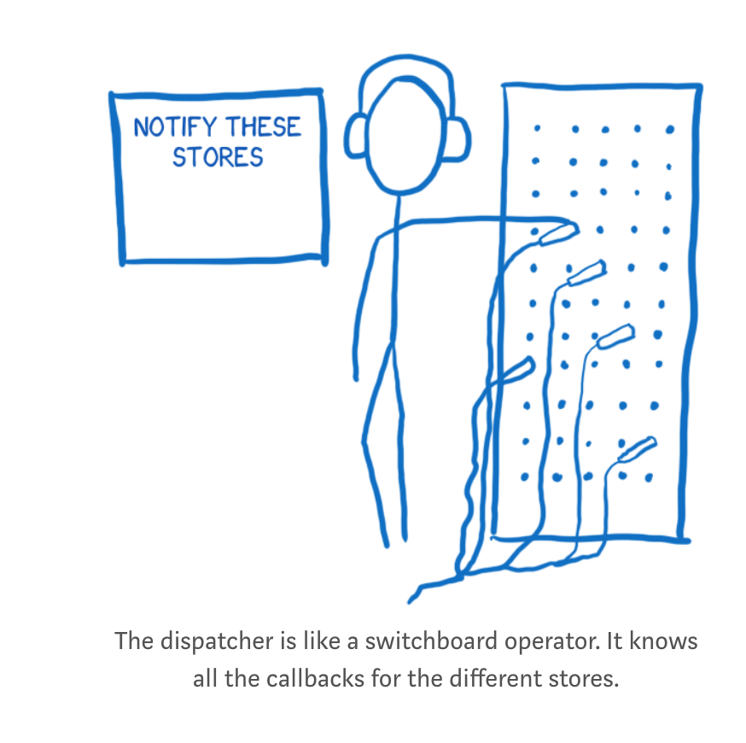
The dispatcher
In Flux, the dispatcher is basically a big registry of callbacks. It keeps a list of all of the stores that it needs to send actions to (there’s more than 1 store). When an action comes in from the action creator, it will pass the action around to different stores.
Unlike Flux, action creators in Redux do not send the action to the dispatcher. Instead, they return a formatted action object.

Slide 48
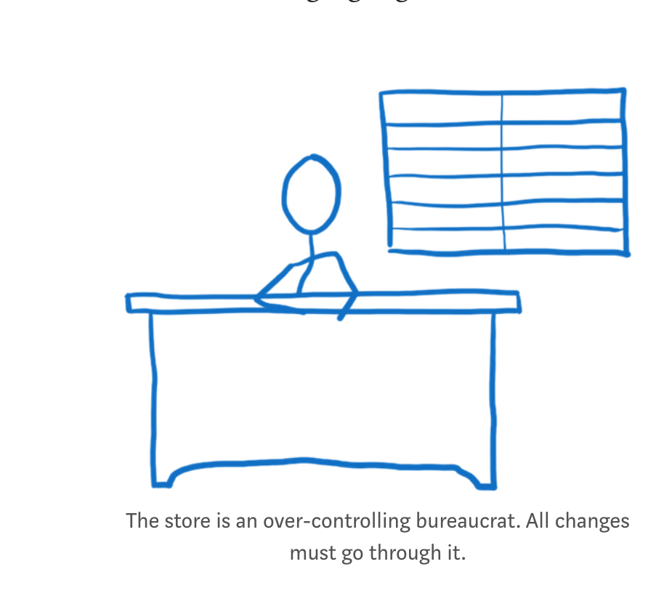
The store
If a store is registered with the dispatcher, all actions will be sent to it.
Inside the store there’s usually a switch statement that looks at the action type to decide whether or not this store cares about this action.
In Flux, you can have multiple stores. Each store has its own little fiefdom, and it is in total control. It holds on to its little slice of state, and has all the logic for changing that little slice of state.
In redux, you have only 1 store.
It takes care of holding on to the whole state tree. It then delegates the work of figuring out what state changes need to happen. The reducers, headed up by the root reducer, take on this task.

Slide 49
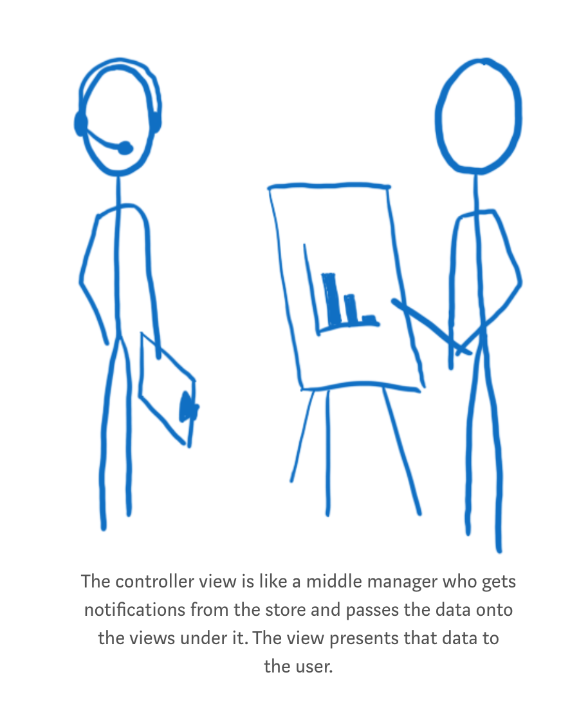
The controller view and the view (Flux)
The view is a presenter. As far as it’s concerned, it just receives data out of the sky and formats it into HTML.
The controller view is like a middle manager between the store and the view. The store tells it when the state has changed. It collects the new state and then passes the updated state along to all of the views under it.

Slide 50
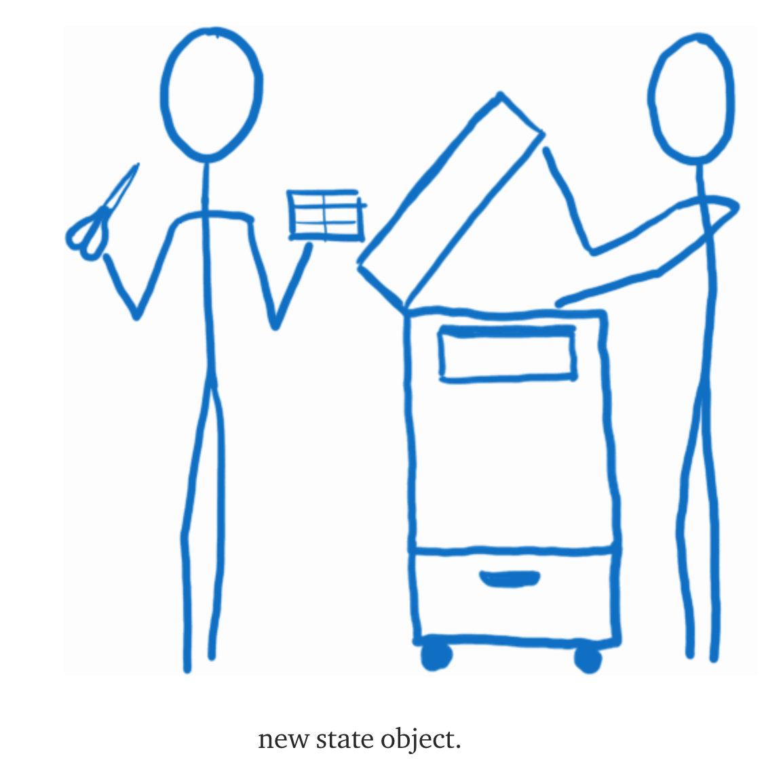
Reducers
“I think of the reducers as a department of white-collar workers who are a little overzealous about photocopying. They don’t want to mess anything up, so they don’t change the state that has been passed in to them. Instead, they make a copy and make all their changes on the copy.”

Slide 51
Flux v. Redux
This is another difference between Flux and Redux. In Flux, the stores aren’t necessarily connected to each other and they have a flat structure. In Redux, the reducers are in a heirarchy. This hierarchy can have as many levels as needed, just like the component hierarchy.

Slide 52
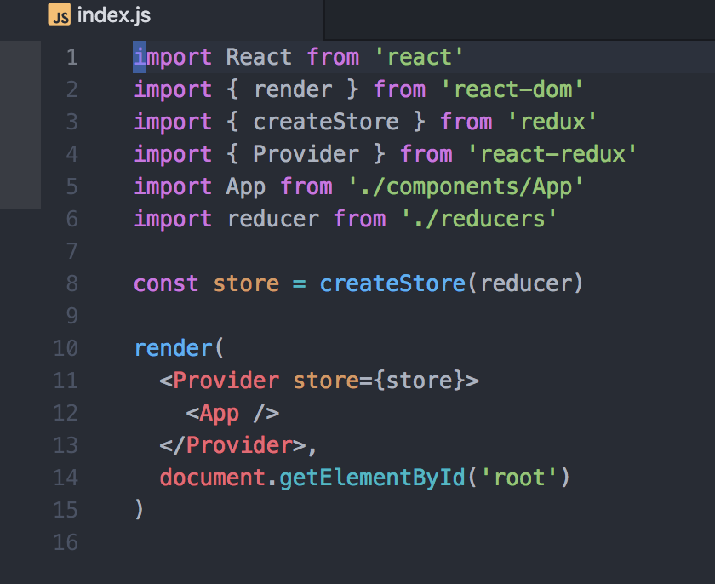
A more complex example: Todos

Slide 53
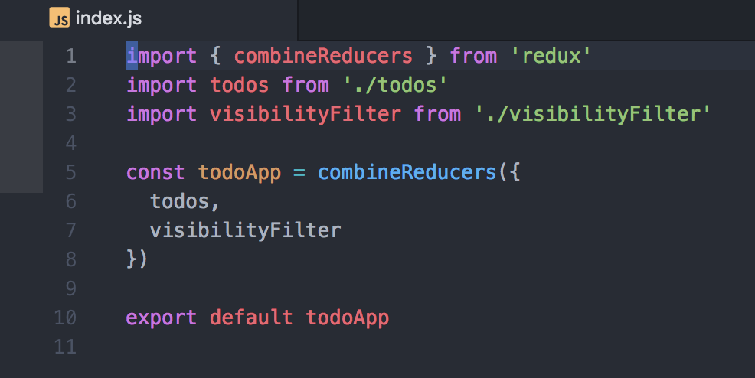
To get a sense of the state:

Slide 54
CombineReducers(reducers)
turns an object whose values are different reducing functions into a single reducing function
The resulting reducer calls every child reducer, and gathers their results into a single state object. The shape of the state object matches the keys of the passed reducers.
You can control state key names by using different keys for the reducers in the passed object. For example, you may call combineReducers({ todos: myTodosReducer, counter: myCounterReducer })for the state shape to be { todos, counter }.

Slide 55
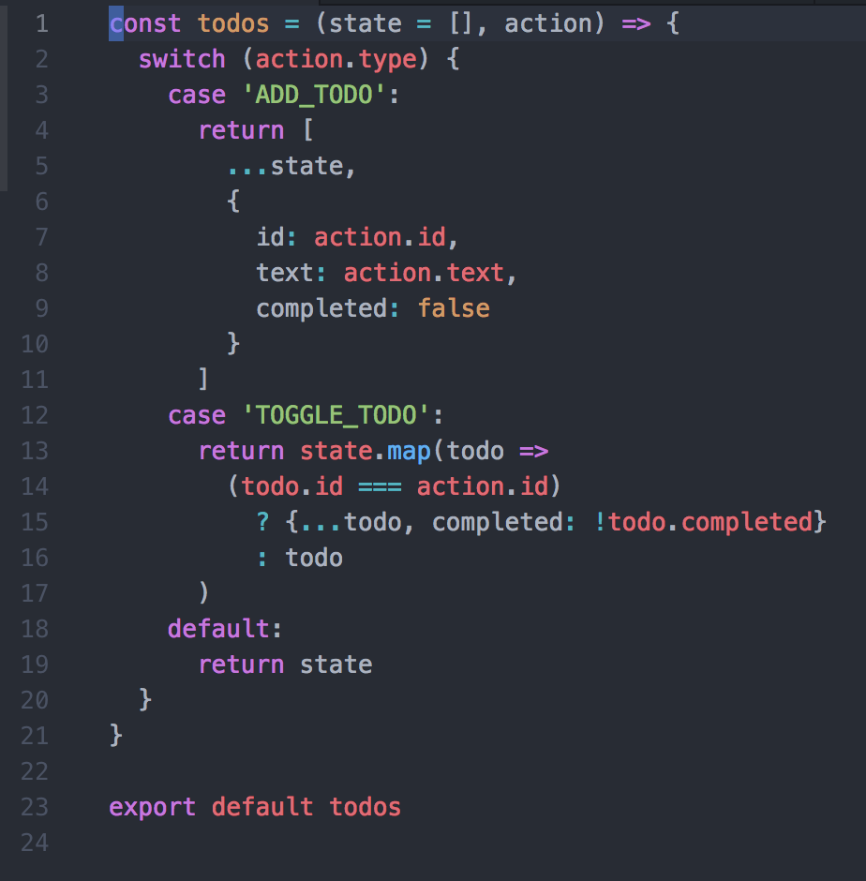
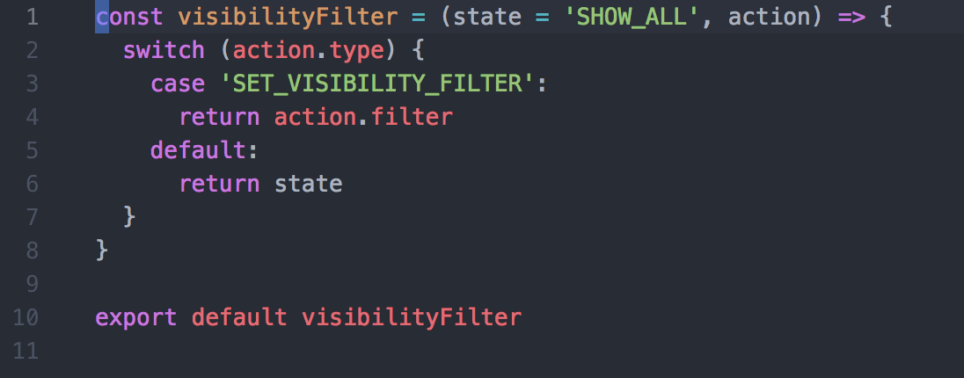
Reducers

Slide 56
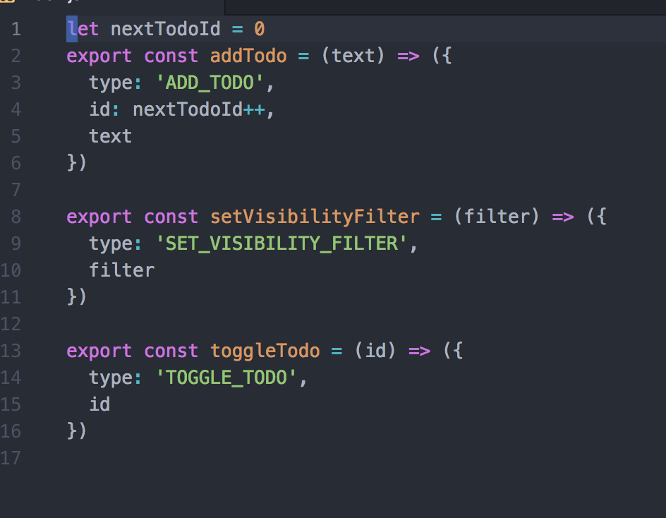
Actions

Slide 57
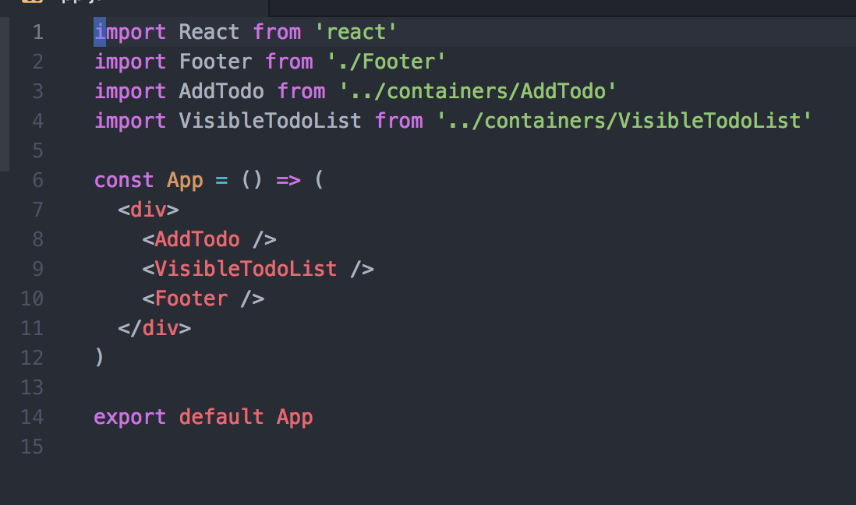
Components

Slide 58
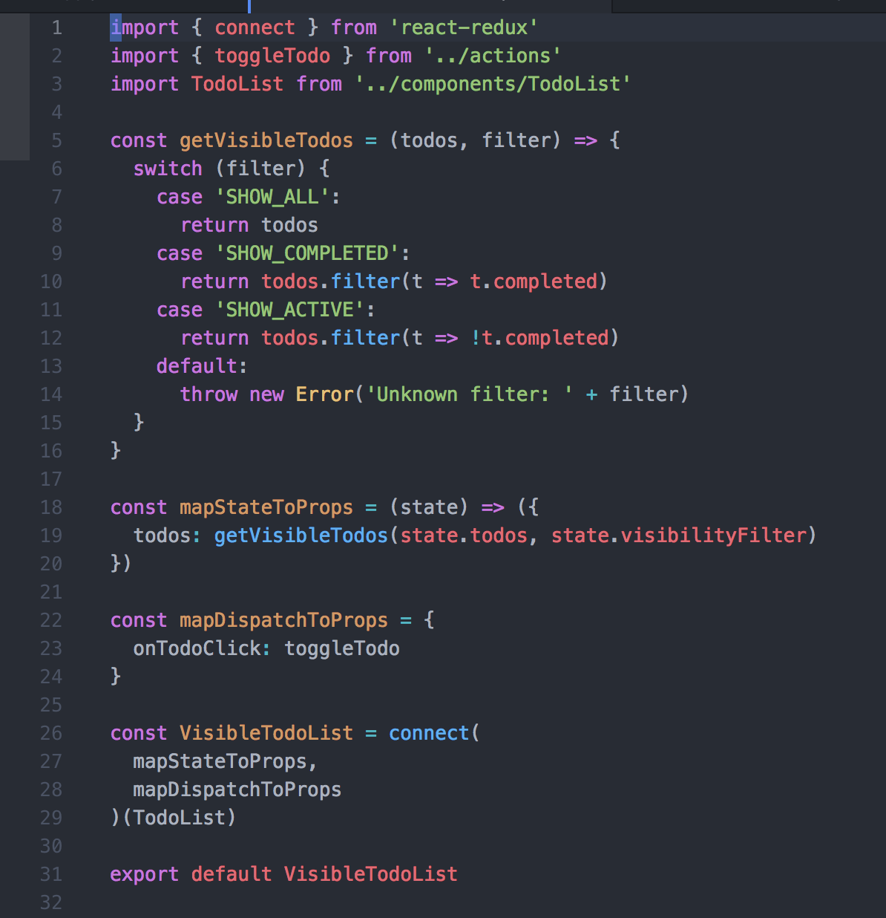
Containers

Slide 59
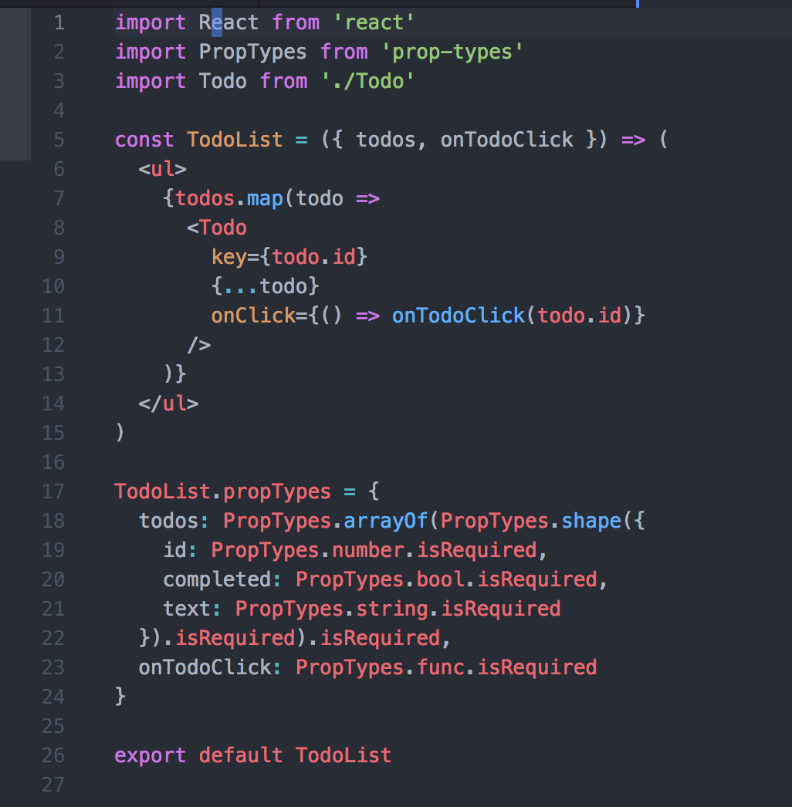
Components

Slide 61
Does everyone everywhere need Redux?
‘You might not need Redux’ – Dan Abramov
People often choose Redux before they need it. “What if our app doesn’t scale without it?” Later, developers frown at the indirection Redux introduced to their code. “Why do I have to touch three files to get a simple feature working?” Why indeed!
Redux offers a tradeoff. It asks you to:
Describe application state as plain objects and arrays.
Describe changes in the system as plain objects.
Describe the logic for handling changes as pure functions.
None of these limitations are required to build an app, with or without React. In fact these are pretty strong constraints, and you should think carefully before adopting them even in parts of your app.
Do you have good reasons for doing so?

Slide 62
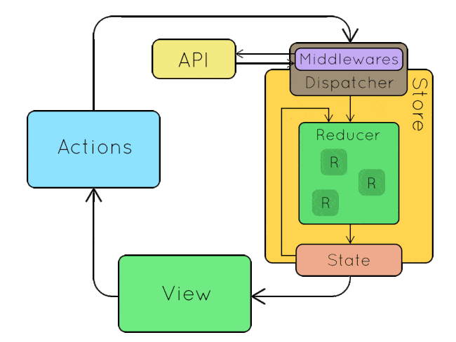

Slide 63
Middleware
From the docs:
Middleware is not baked into createStore and is not a fundamental part of the Redux architecture, but we consider it useful enough to be supported right in the core.
This way, there is a single standard way to extend dispatch in the ecosystem, and different middleware may compete in expressiveness and utility.

Slide 64
Sagas/Thunks/Middleware
redux-saga is a library that aims to make side effects (i.e. asynchronous things like data fetching and impure things like accessing the browser cache) in React/Redux applications easier and better.

Slide 65
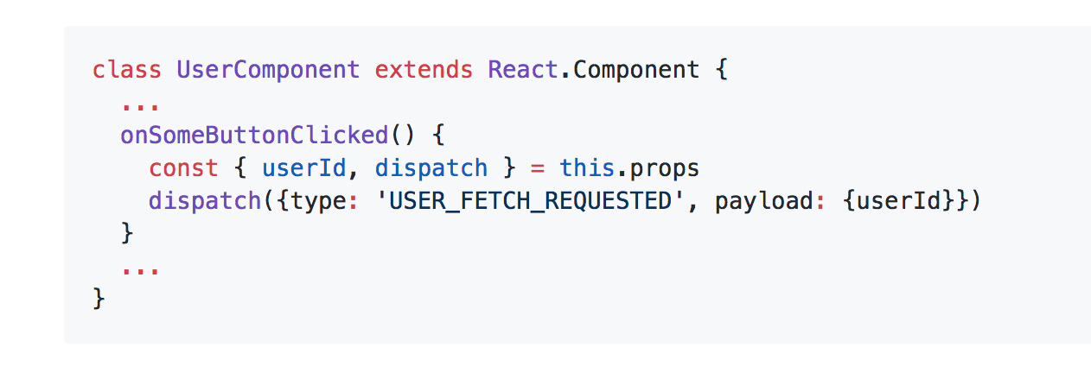
Suppose you want to fetch some data

Slide 66
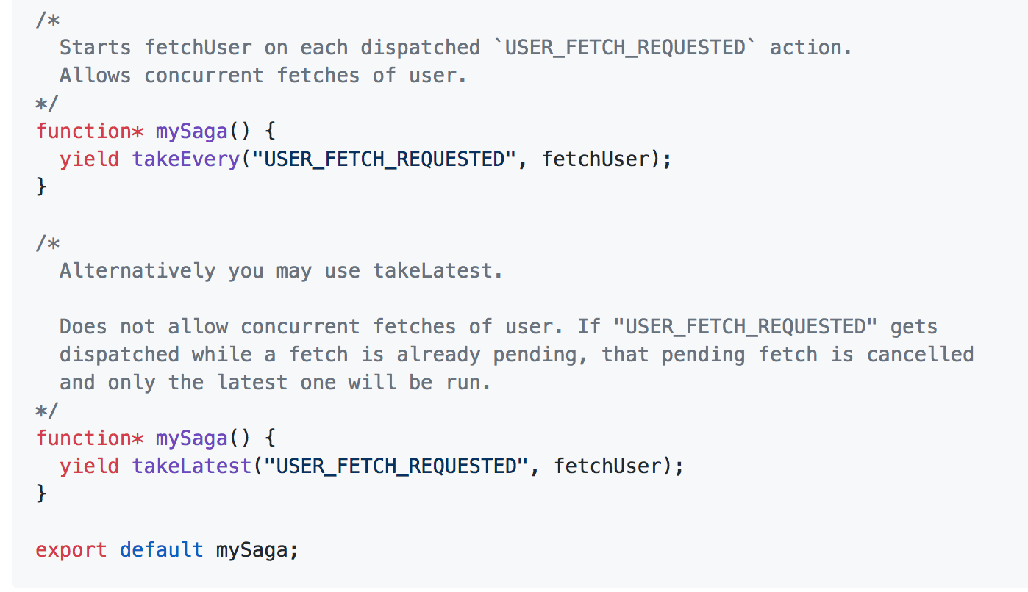
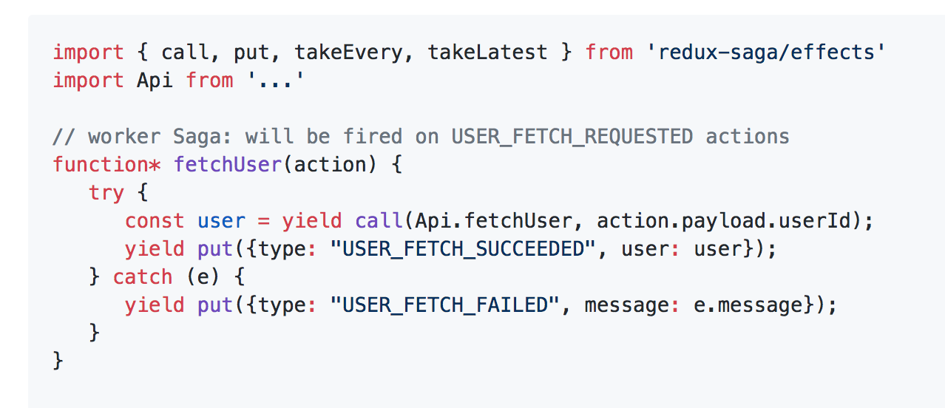
We'll create a Saga that watches for all USER_FETCH_REQUESTED actions and triggers an API call to fetch the user data.

Slide 67
Kicking off the Request

Slide 68
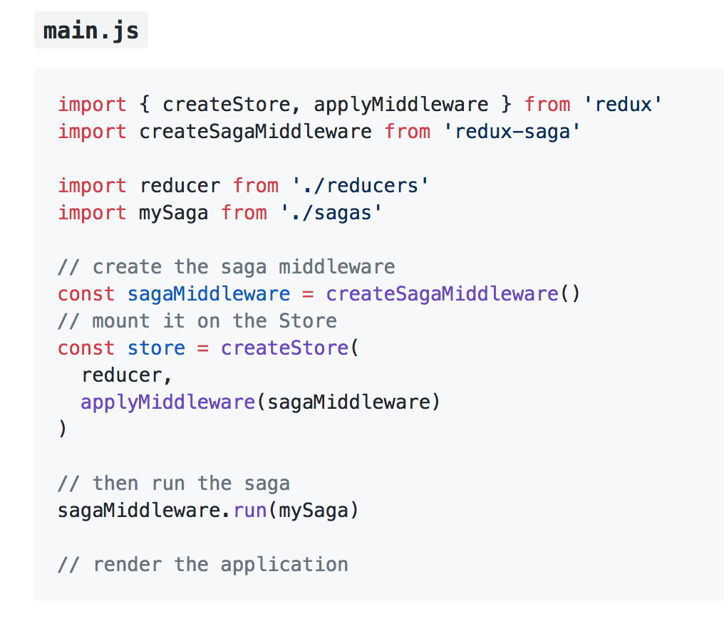
To run our Saga, we'll have to connect it to the Redux Store using the redux-saga middleware.

Slide 69
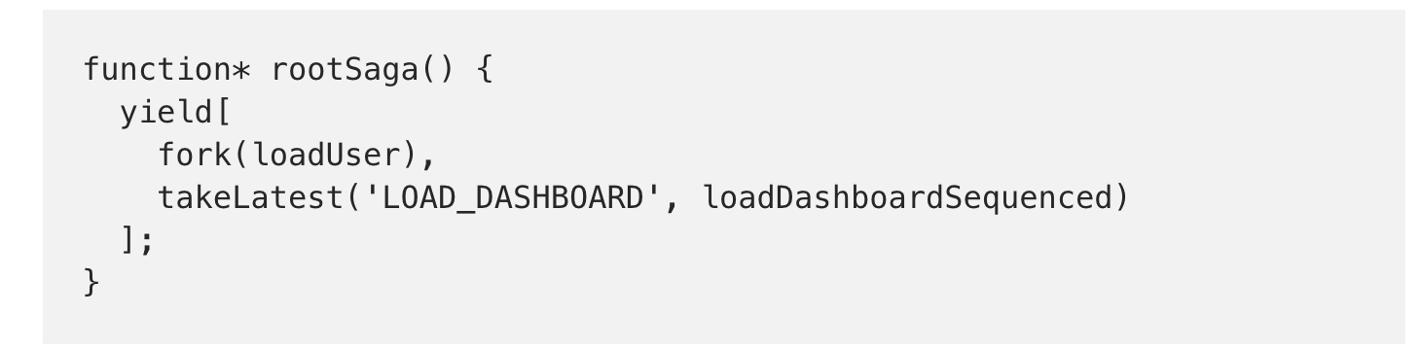
Another example: Create our saga generator and register the Sagas

Slide 70
Redux saga expose several methods called Effects
Fork performs a non-blocking operation on the function passed.
Take pauses until action received.
Race runs effects simultaneously, then cancels them all once one finishes.
Call runs a function. If it returns a promise, pauses the saga until the promise is resolved.
Put dispatches an action.
Select Runs a selector function to get data from the state
takeLatest means we are going to execute the operations, then return only the results of the last one call. If we trigger several cases, it’s going to ignore all of them except the last one.
takeEvery will return results for all the calls triggered.

Slide 71
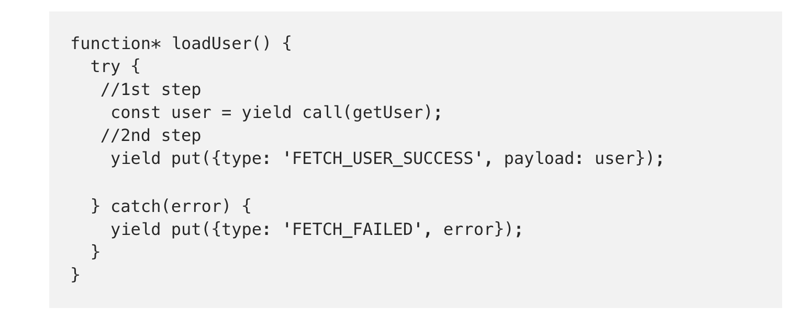
loadUser Saga

Slide 72
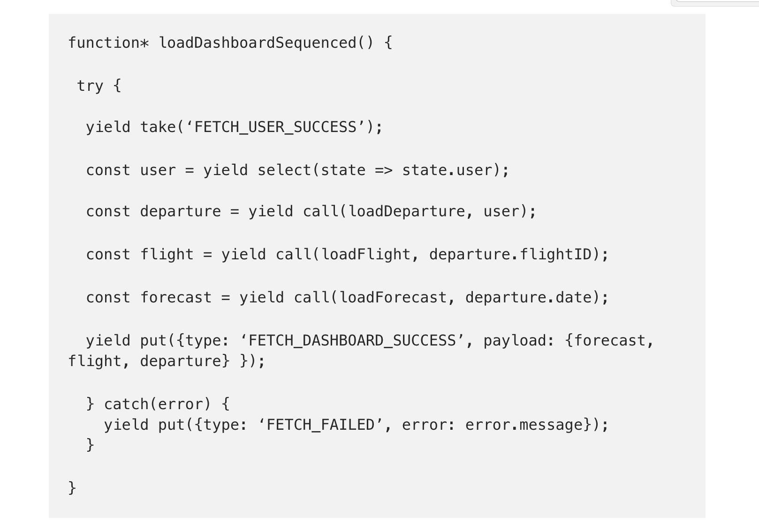

Blocking Saga

Slide 73
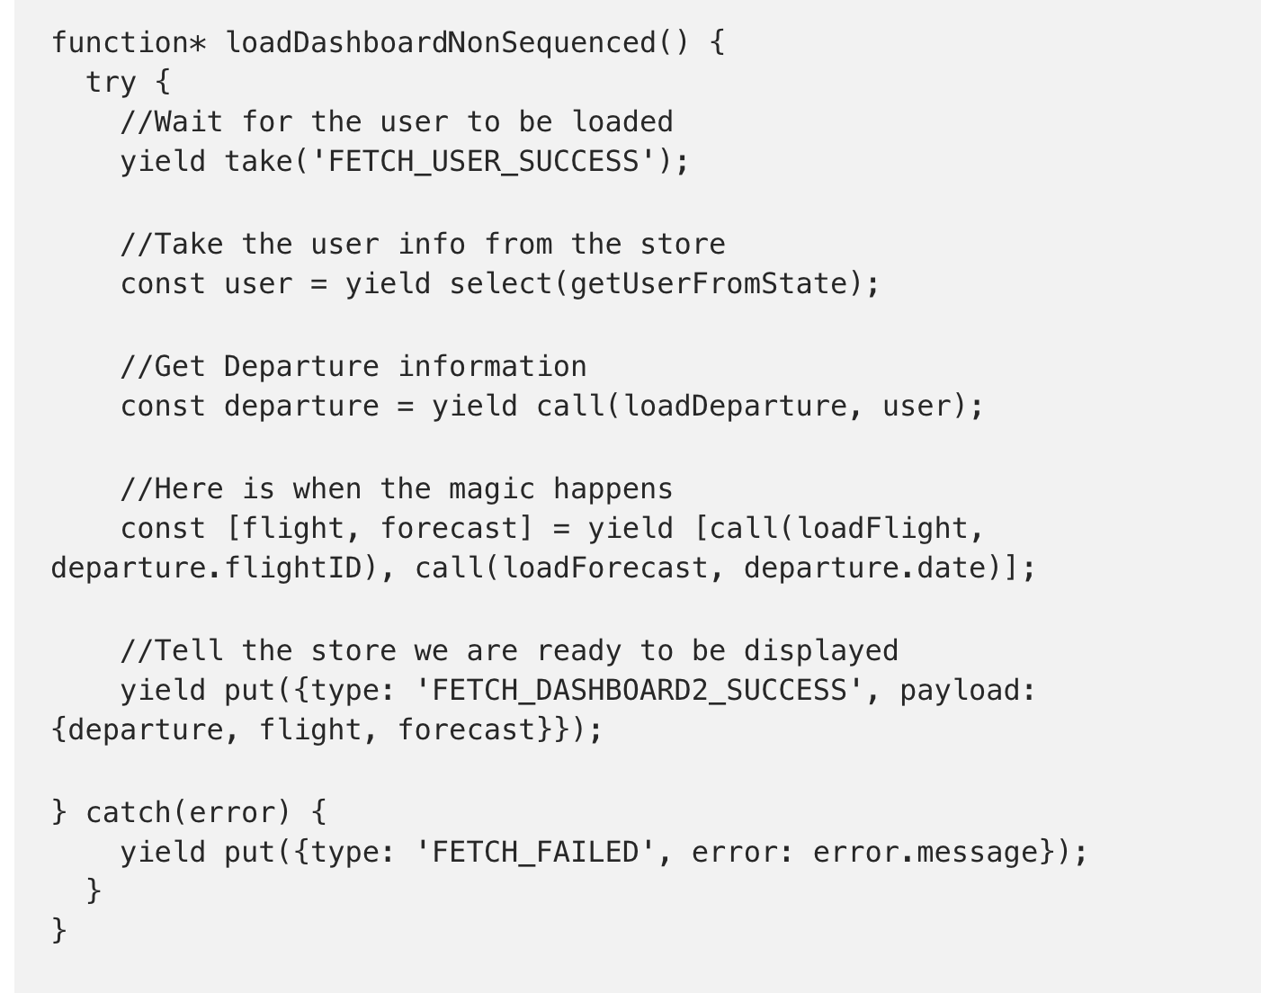
Non-blocking Saga

Slide 74


If that’s fuzzy, that’s ok

Slide 75
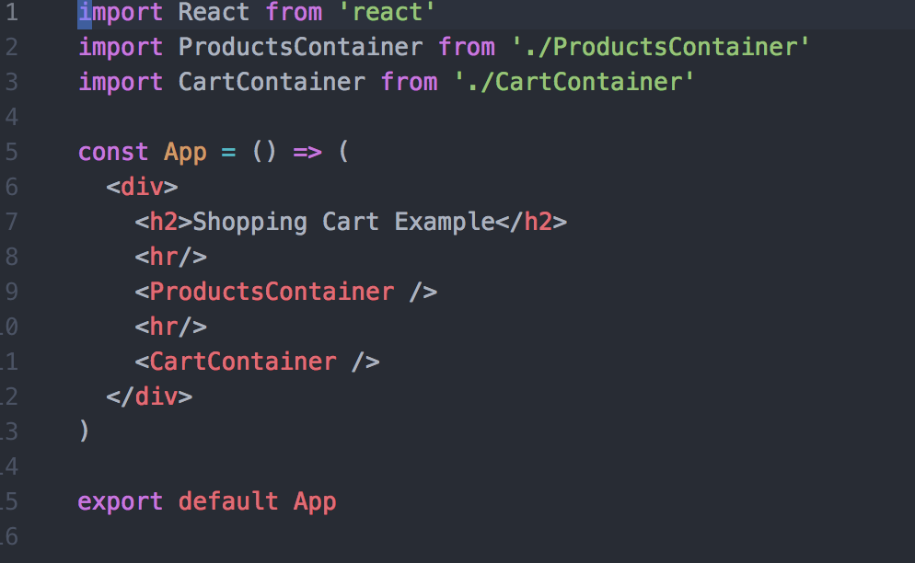
A final example

Slide 76

A shopping cart container

Slide 77

Selectors
A selector is a function that knows how to extract a specific piece of data from the store.

Slide 78


Slide 79

Product

Slide 80


Slide 81

Mock API

Slide 82
Additional Reading/Sources
The docs (of course): http://redux.js.org/docs/introduction/
Mark’s Dev Blog (advanced): http://blog.isquaredsoftware.com/2017/01/idiomatic-redux-thoughts-on-thunks-sagas-abstraction-and-reusability/
Async operations using redux-saga (advanced): https://medium.freecodecamp.org/async-operations-using-redux-saga-2ba02ae077b3
Getting Started with Redux: https://egghead.io/courses/getting-started-with-redux
Leveling up with React/Redux: https://css-tricks.com/learning-react-redux/
D. Abramov on SO: https://stackoverflow.com/users/458193/dan-abramov
React-redux-starter-kit: https://github.com/davezuko/react-redux-starter-kit
Code cartoons: https://code-cartoons.com/a-cartoon-intro-to-redux-3afb775501a6 and https://code-cartoons.com/a-cartoon-guide-to-flux-6157355ab207
Database normalization: https://www.studytonight.com/dbms/database-normalization.php
Normalizing state shape: http://redux.js.org/docs/recipes/reducers/NormalizingStateShape.html
You may not need Redux: https://medium.com/@dan_abramov/you-might-not-need-redux-be46360cf367
Higher Order Components: https://medium.com/@dan_abramov/mixins-are-dead-long-live-higher-order-components-94a0d2f9e750
Generators: https://github.com/gajus/gajus.com-blog/blob/master/posts/the-definitive-guide-to-the-javascript-generators/index.md
Redux-saga: https://github.com/redux-saga/redux-saga

Slide 83


A special thanks

